Slide 1
MACHINE LEARNING USING SPARK AND PYTHON
Submitted by K V V S Krishna Prasad
A21016

Slide 2
Research objective
We all know there’s a lot about ecommerce that’s complicated. An ecommerce business must be agile, and its decision-makers switched on to succeed. When you get right down to it, though, the heart of online retail remains simple.
But how do you know what consumers want? And, more importantly, what might they demand next week, month, or year? Ay, there’s the rub, as Shakespeare might say. It’s also where ecommerce demand forecasting comes in.
Ecommerce demand forecasting is the process of predicting the future demand for products. That could be new products or those that you’ve been selling for years. The best way of forecasting demand is by using historical data.

Slide 3
Why future prediction is important?
Machine learning model predictions allow businesses to make highly accurate guesses as to the likely outcomes of a question based on historical data, which can be about all kinds of things – customer churn likelihood, possible fraudulent activity, and more.
In our ruminating and decision-making we are constantly looking forward, trying to decide the best course of action to achieve our goals and avoid potential discomforts. If we can predict accurately, then we will make good decisions and be successful in meeting our goals and objectives.

Slide 4
Approaching our problem
Creating the spark environment
Loading the required libraries
Loading the data
Understanding the data
Exploratory data analysis
Application of different Machine learning algorithms
Finding solution in terms of prediction

Slide 5
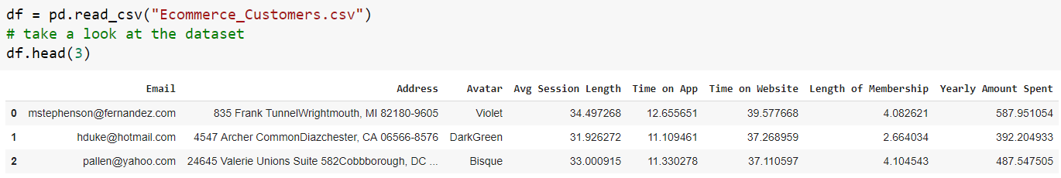
THE DATASET
Ecommerce_Customers.csv

Slide 6
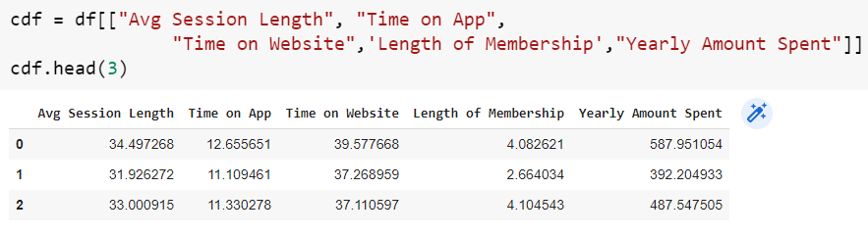
selecting some features that we want to use for regression.

Slide 7
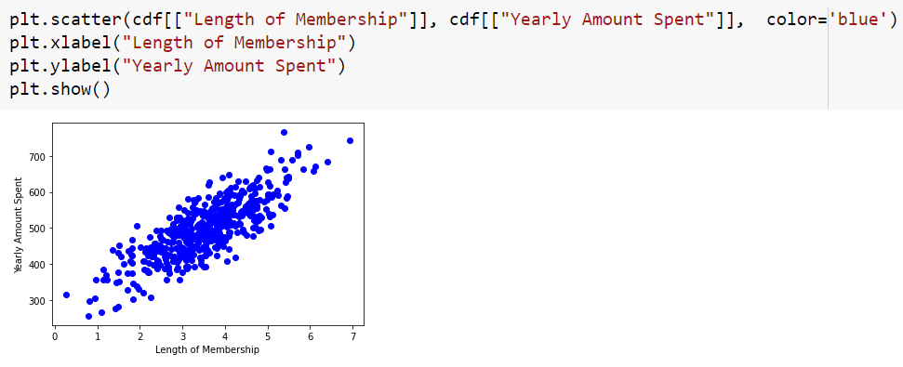
PLOTTING THE YEARLY AMOUNT SPENT WITH RESPECT TO LENGTH OF MEMBERSHIP

Slide 8
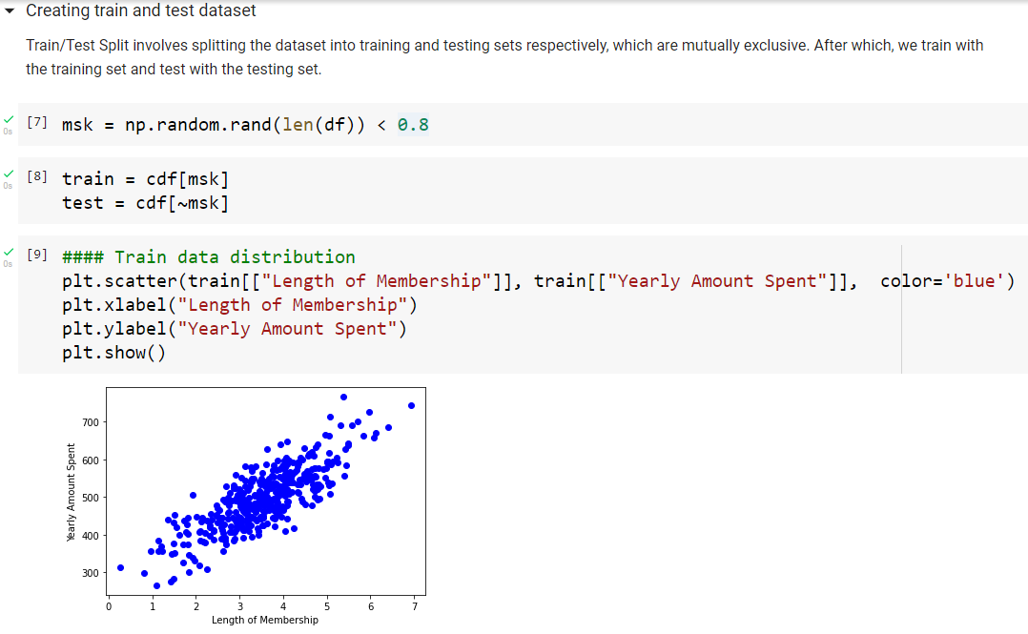
Creating train and test dataset

Slide 9
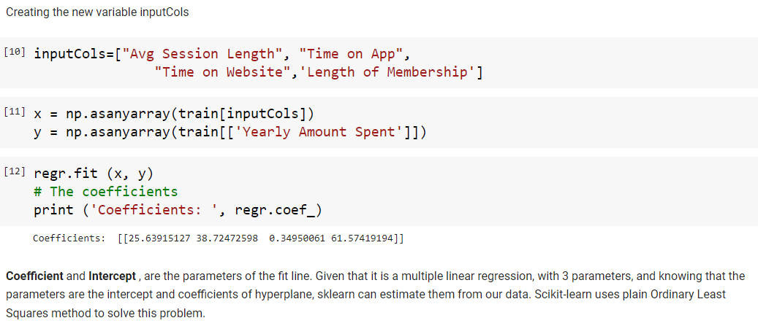
Creating the new variable inputcols

Slide 10
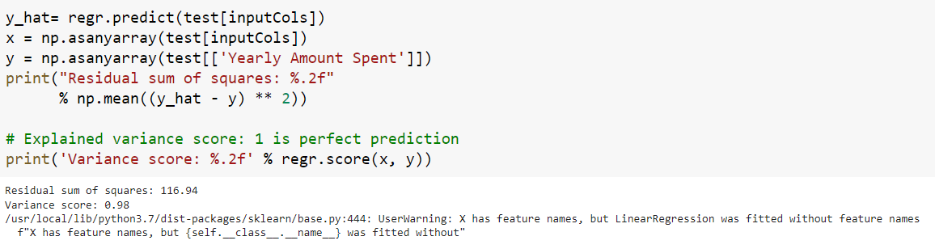
Prediction
Explained variance score: 1 is perfect prediction
Variance score : 0.98

Slide 11
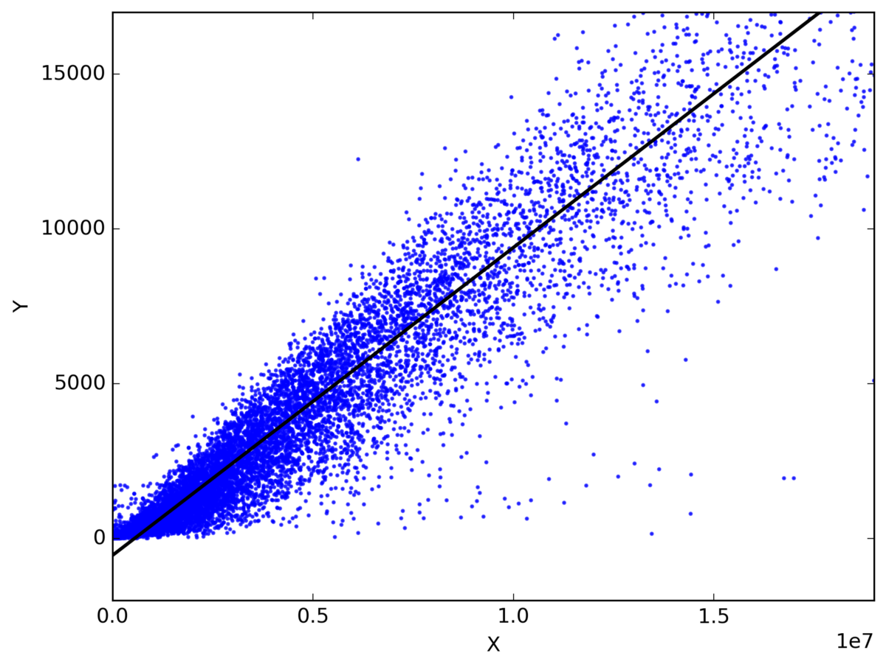
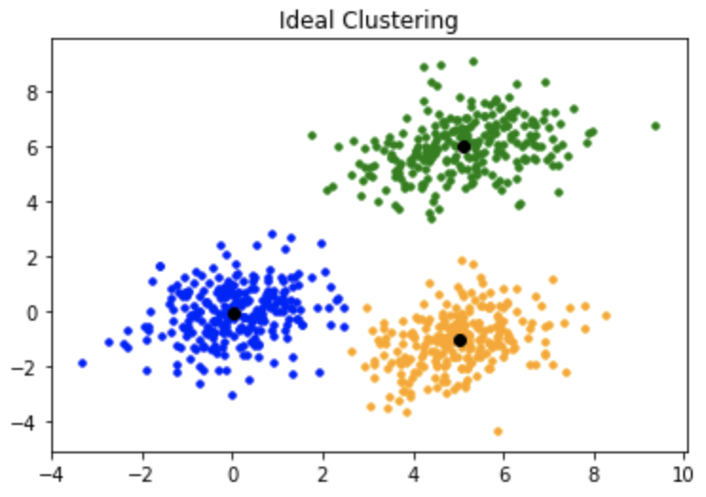
MODELS
Linear Regression
K means Clustering

Slide 12
Linear regression model
Regression is a method of modelling a target value based on independent predictors. This method is mostly used for forecasting and finding out cause and effect relationship between variables. Regression techniques mostly differ based on the number of independent variables and the type of relationship between the independent and dependent variables.
Simple liner regression is a type of regression analysis where the number of independent variables is one and there is a linear relationship between the independent (x) and dependent (y) variable. Based on the given data points, we try to plot a line that models the points the best. The line can be modelled based on the linear equation shown below :
Y = a_0 + a_1 * x

Slide 13
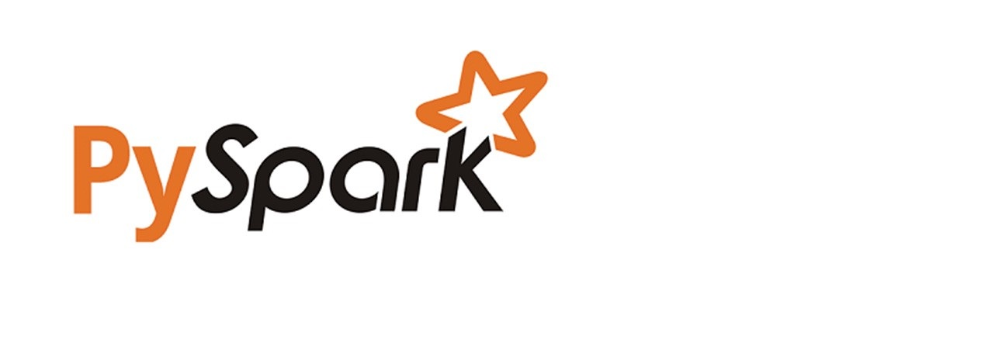


Linear Regression with Pyspark
Installing pyspark in cloud and importing the required libraries

Slide 14
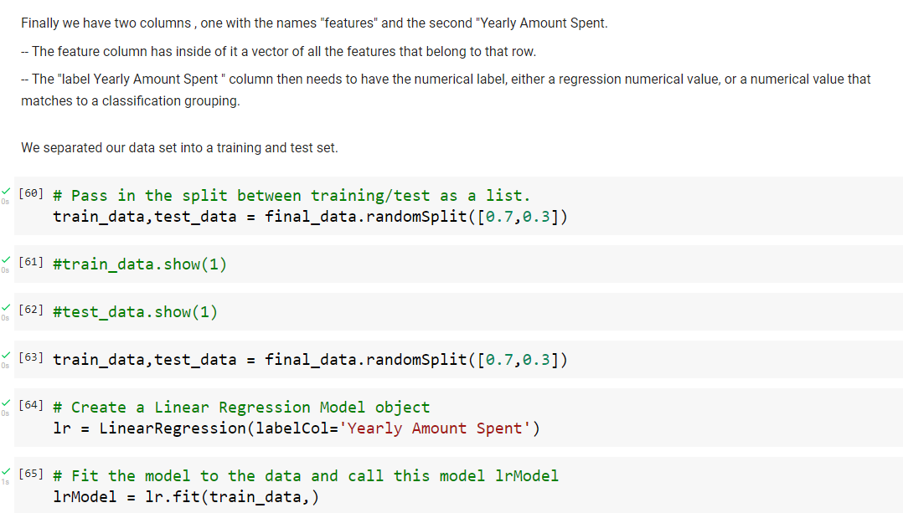
Separating the data into training and testing data and fitting into linear regression model

Slide 15
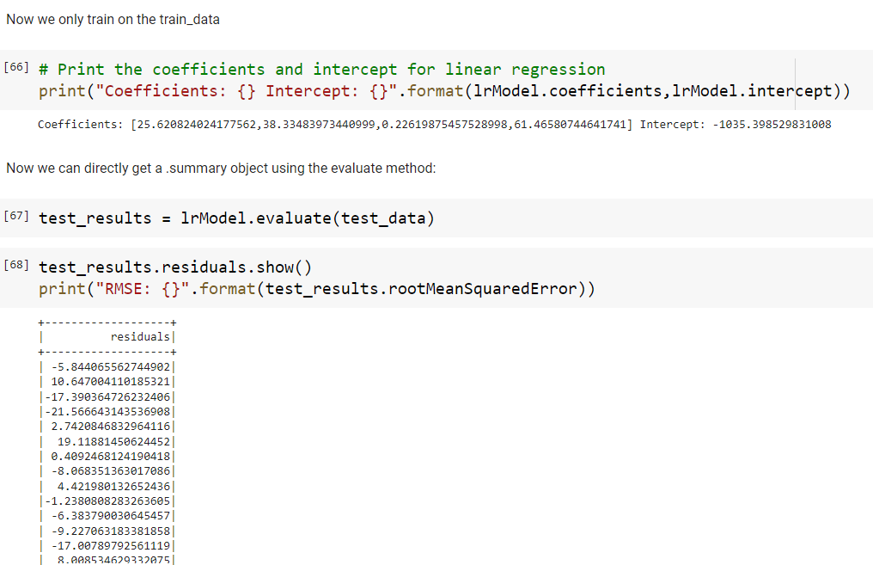
Training the data and testing the results

Slide 16
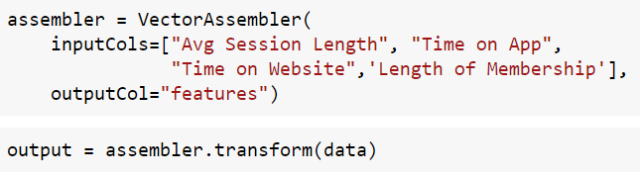
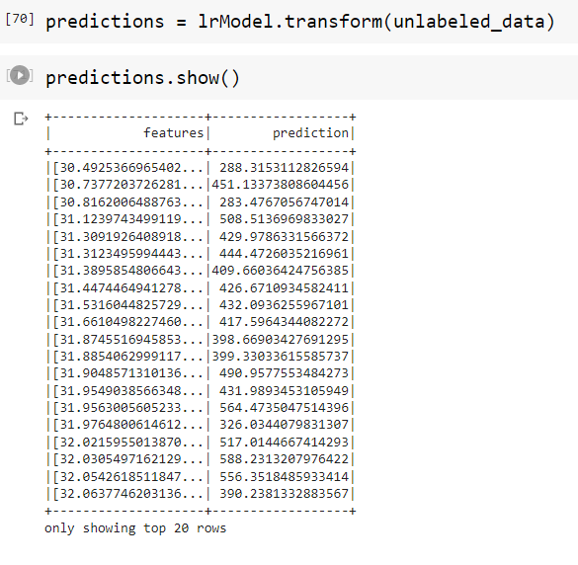
Final prediction results
## Based on the inputs of avg session length, time on app, time on website and length of membership, we able to successfully predict the customers yearly amount spent on our website.

Slide 17
K means clustering model
K means is one of the most popular clustering algorithms. In this algorithm, a user-specified number of clusters (k) are randomly assigned to different points in the dataset.
Choosing the right value of k is an extremely important aspect of using this algorithm successfully. There is no real prescription for the number of clusters you need, so we will likely have to experiment with the number of values and consider what we would like the end result to be.

Slide 18
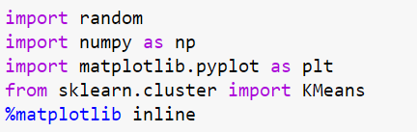

K means clustering with pyspark
Importing the required libraries and loading the dataset into k means

Slide 19
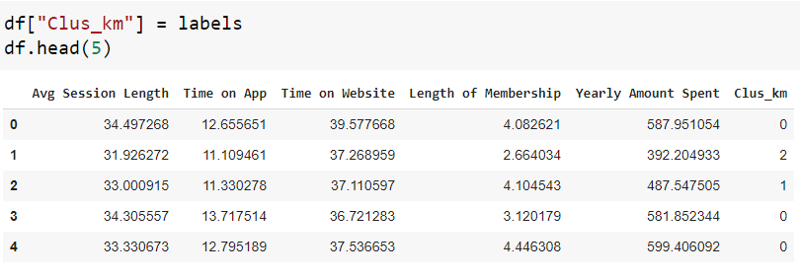
Assigning cluster labels to the data

Slide 20
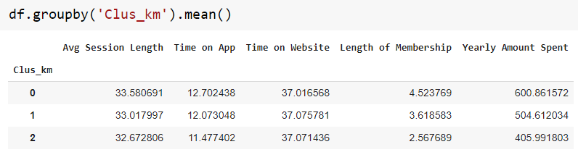
Grouping the data as per the cluster number based on centroid values obtained from features

Slide 21
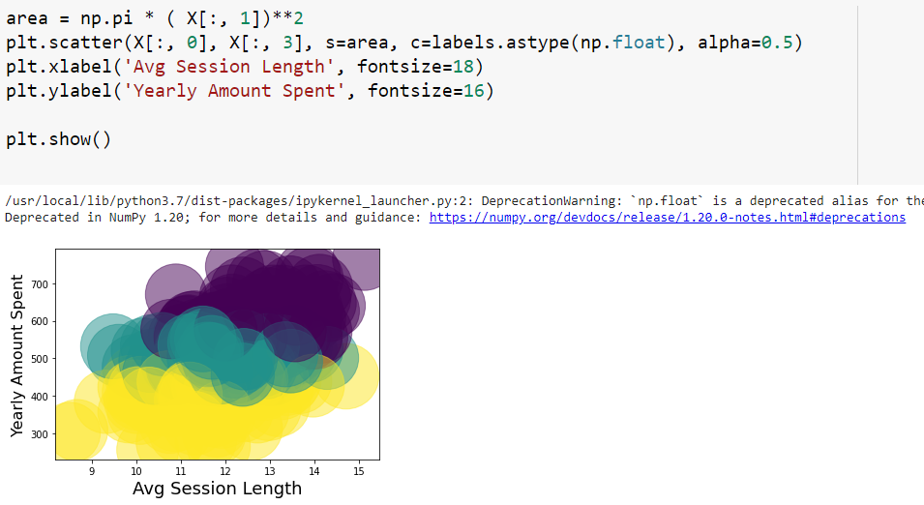
Clustering
Via clustering we are able to see that the customers are falling under three different clusters. They are segregated based on the avg session length and yearly amount spent.

Slide 22
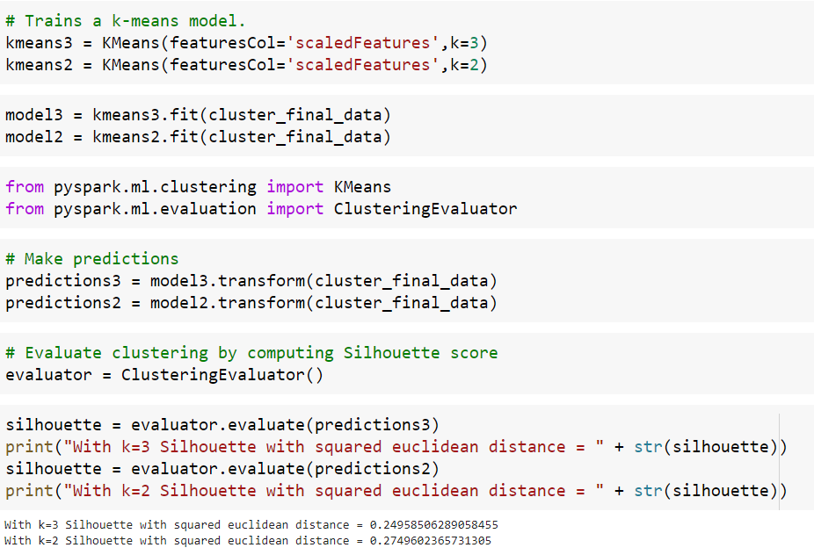
Training the model and evaluating the prediction results

Slide 23
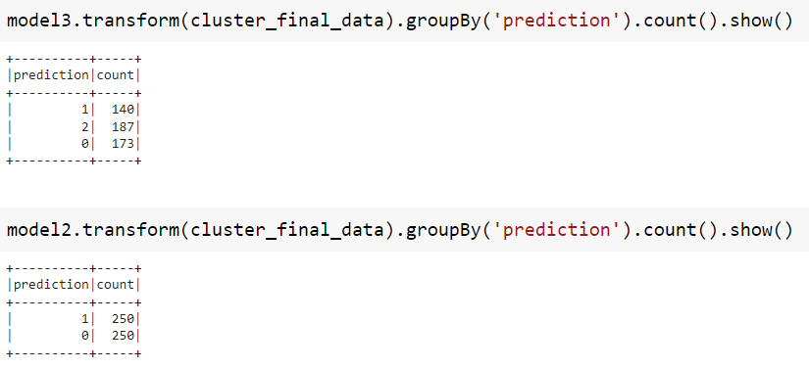
Final model prediction results
The model predicts that the number of customers falling into 2 clusters are 250 each and when we make them into three clusters, the number of customers in each cluster will be 140, 187 and 173 respectively.

Slide 24

THANK YOU

